Slide 1


IT LOG ANALYSER
TROJAN HORSE
LOG FUSION

Slide 2





The Team
Mudassiruddin
Shaik Abrar
TEAM MEMBER
Himayath Aly
Muqtadir Ahmed

Slide 3
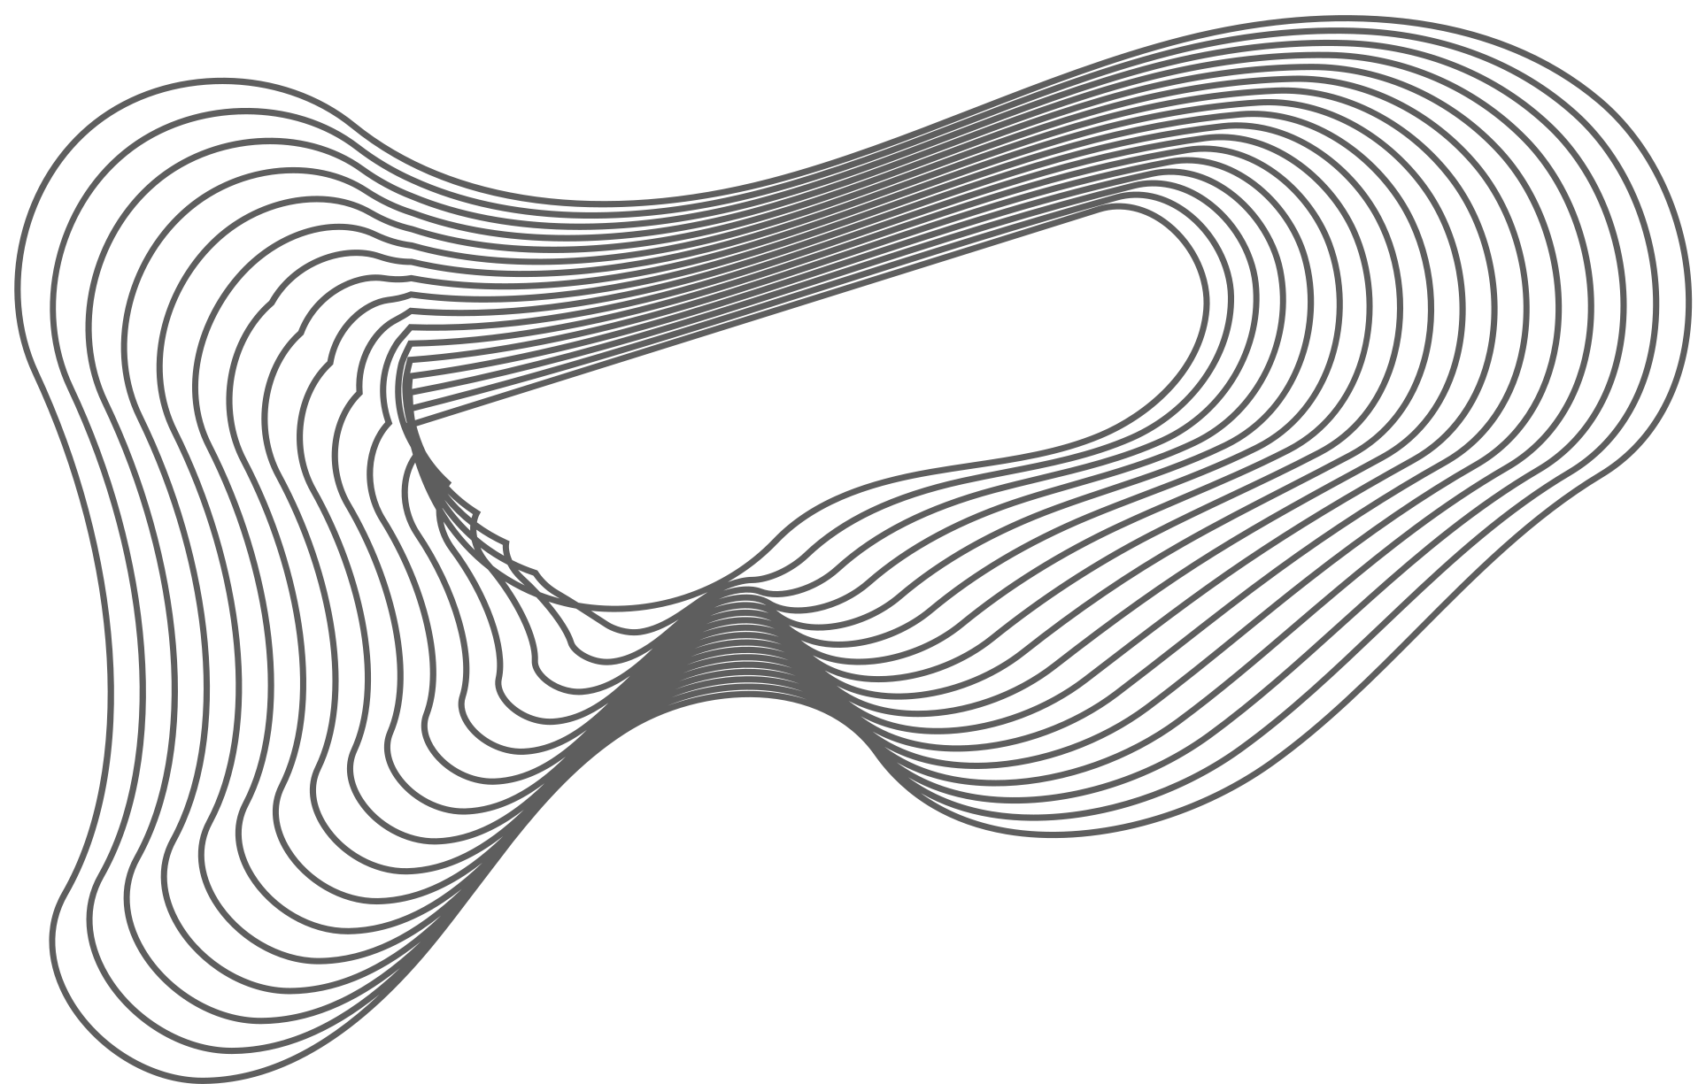
PROBLEM STATEMENT
IT SYSTEM LOG ANALYSER: There is currently no centralized system in place for experts to analyze IT system logs, evaluate potential threats, and identify breaches.
Log Analysis helps to discover many loopholes in networks that are opened intentionally by attackers or unintentionally because of misconfiguration, and bugs in the Software, Hardware, and Firmware.

Slide 4
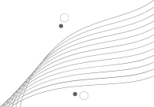
SOLUTION
IT SYSTEM LOG ANALYSER: We have developed a log analyzer integrating blockchain, cloud computing, and machine learning for secure and tamper-proof log storage and efficient monitoring. Utilizing blockchain ensures the integrity of log records, making them immutable and resistant to manipulation or forgery. The system includes:-
1. Log Generator Devices
2. Local Log Servers for collection and processing
3. Log Monitoring Clients for analysis
4. Logging Cloud Server employing blockchain
Updates to centralized log servers require consensus and valid approval from all participating network and sub-network nodes, ensuring a robust and secure logging infrastructure

Slide 5


USP
Real-time analysis and customizable alerts: customizable alerts and notifications based on specific log patterns or security events, ensuring prompt response to potential issues.
The system offers interactive data visualization tools, including graphs and charts, to help experts gain insights from log data more effectively.
We employed InterPlanetary File System (IPFS) for decentralized storage in blockchain, eliminating failure points. Cryptographic hashes ensure data integrity, reducing redundancy and preserving decentralization for off-chain data.
This can lead to high storage costs, especially for large datasets.

Slide 6
FLOW CHART
Past hour logs are encrypted and sent to centralized server
Log
Generated
Log stored in
Local server
Log file containing logs with risk level in encrypted and stored in IPFS and address to the file is stored in Private Blockchain.
Logs are decrypted and Risk level is predicted using Artificial Intelligence and Machine Learning Algorithms
Logs entries are preserved for a retention period before the are deleted

Slide 7

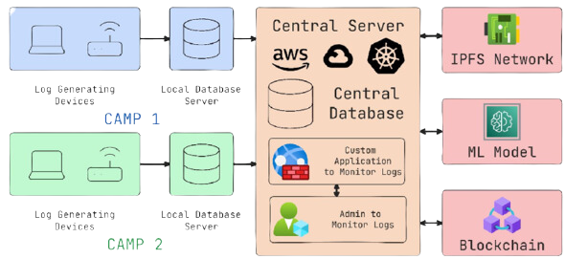
Infra (Diagram)

Slide 8
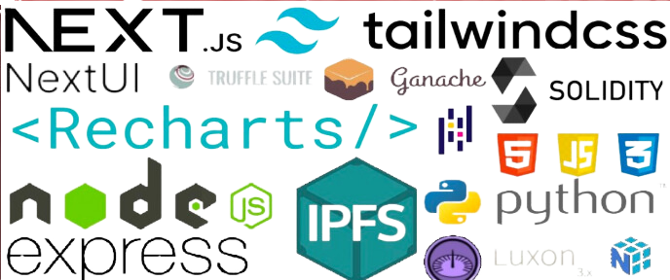
TECH STACK

Slide 9

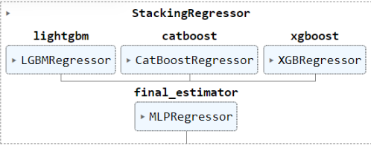
ML Model

Slide 10


Why not just Block chain?
Storing data on a blockchain can be expensive, as each node in the network must replicate and maintain a copy of the entire blockchain, including the stored data. This can lead to high storage costs, especially for large datasets.
As the number of transactions and data stored on the blockchain increases, the network can become congested, leading to slower transaction processing times and higher fees.
Executing operations on a blockchain, such as storing data or executing smart contracts, incurs gas costs.

Slide 11
What is IPFS?
IPFS is an open sourced modular suite of protocols for organizing and transferring data, designed from the ground up with the principles of content addressing and peer-to-peer networking.
IPFS works by connecting computers in a networkto enable them to share files. Each file and its contents are given a unique hash, and when someone requests a file, the network locates it based on that hash.
Video on how data is stored in IPFS
Idea behind IPFS

Slide 12
Why IPFS?
IPFS offers several advantages over traditional file storage and sharing systems:
Decentralization: Unlike centralized systems, IPFS distributes data across a network of nodes, reducing reliance on single servers and enhancing resilience.
Content Addressing: Files are accessed based on their content rather than location, improving efficiency and enabling tamper-evident and immutable storage.
Prevention of Vendor Lock-in: IPFS's open and participatory nature promotes interoperability and prevents dependency on specific vendors or platforms.
Enhanced Security: Cryptographic hashes uniquely identify files, enhancing security and protecting against unauthorized alterations.

Slide 13

ML Model
In this model, we employ the Stacking concept, combining three strong regressors - XGBoost, CatBoost, and LightGBM.
A meta regressor, MLPRegressor, is used to finalize the model.
Instead of a standard train-test split, we opt for cross-validation to mitigate overfitting risks.
Since we are using a dummy dataset it is difficult to predict how well the model will be in practice, butwith techniques like stacking and cross validation weend up with a model that is very well generalized.
With access to a real dataset, we can try hyper parameter tuning, using different models, and feature engineering to further improve our model.

Slide 14

Security Concerns
Authentication via Reverse Proxy: Gateway providers often use reverse proxies to limit access to authenticated requests, ensuring security. This method retains compatibility with various IPFS SDKs and toolkits.
Security and Resilience: IPFS's distribution of files across multiple nodes and consensus-based retrieval enhance security and resilience, particularly for sensitive data.
Comprehensive Security Measures: By combining authentication via reverse proxy, blockchain hashing, and smart contract logic, gateway providers can establish robust security measures for handling sensitive data on the IPFS network.

Slide 15

Architecture safe from hackers?
The consensus mechanism plays a vital role in the security of a blockchain. Select a proven and secure consensus algorithm,such as Proof of Work (PoW) or Proof of Stake (PoS).
Implement firewalls to control incoming and outgoing traffic,and use network segmentation to isolate different componentsof our blockchain network.
IPFS has strict set of rules that does not allow unauthorised access of logs.
Our System being accessible only to a private network logs can only be accessed by just authorised systems.

Slide 16
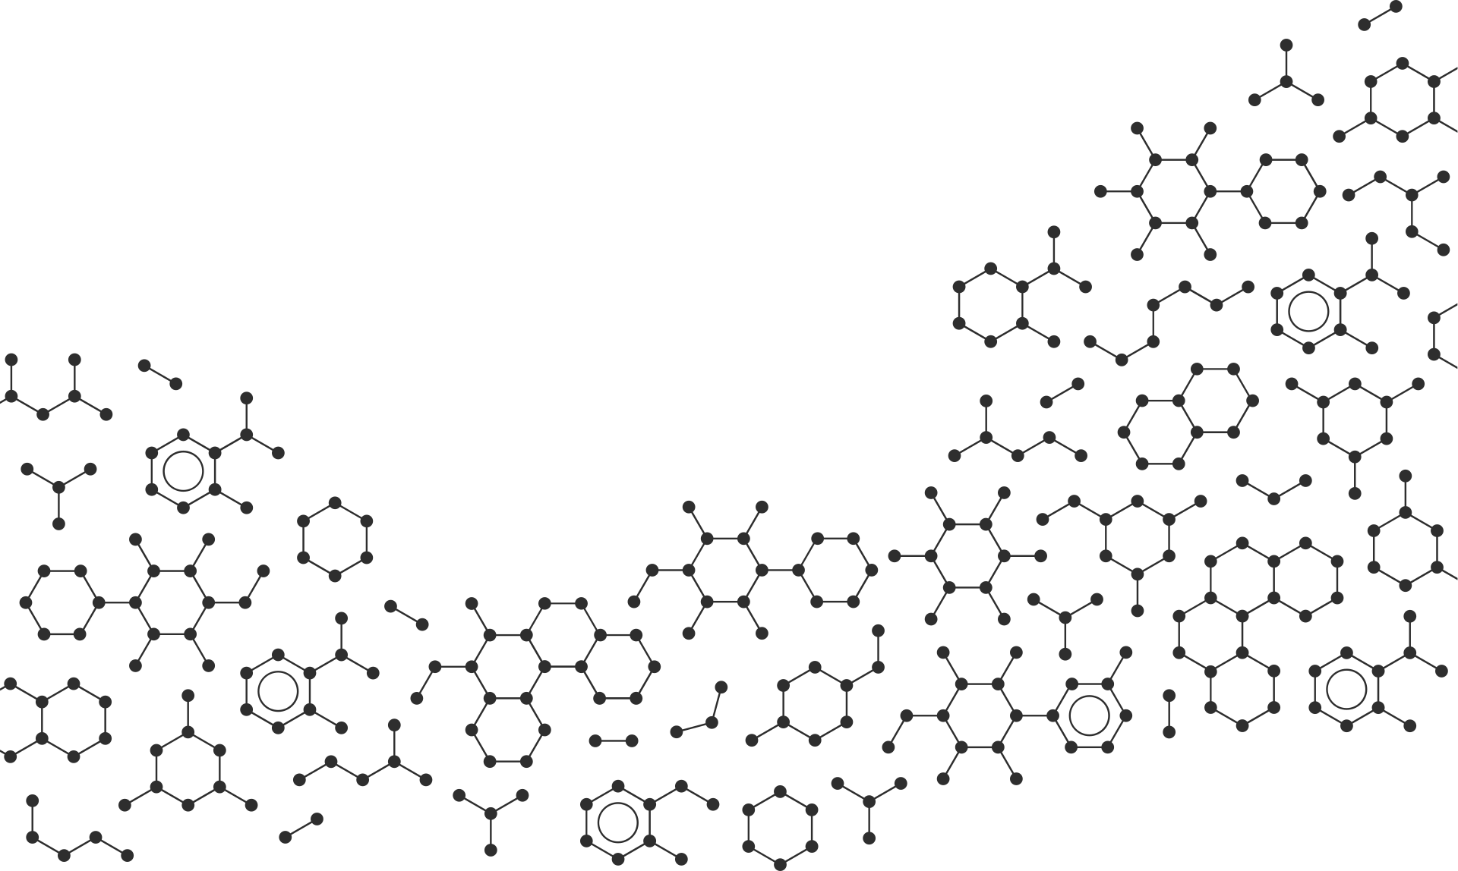
What to do with Trillions of Logs?
Periodic Review and Pruning: Regularly assessing and removing logs that are no longer essential for blockchain integrity ensures efficient use of storage resources and system performance.
Cost-efficient Storage: Archiving non-critical data off the blockchain offers a more economical storage solution, while maintaining essential information within the blockchain for integrity.
Data Analytics and Machine Learning: Extensive logs enable the application of advanced analytics and machine learning algorithms for predictive modeling, leveraging large datasets to derive valuable insights.

Slide 17
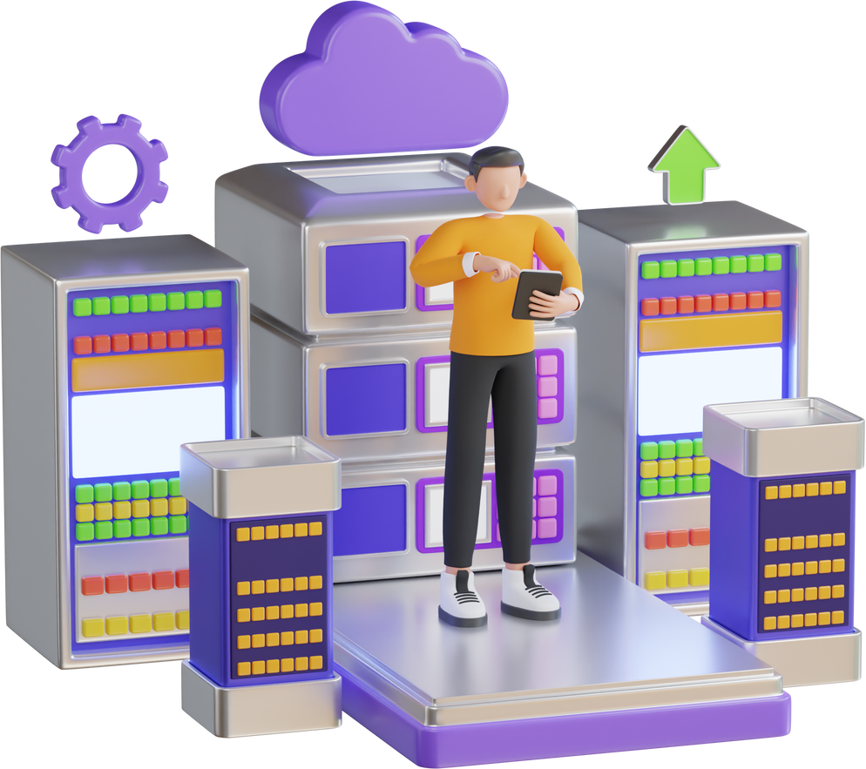
Minimizing Cloud Dependency
We Plan to reduce the dependency on Cloud Providers like AWS by using On-Premises Data Center for storing data as they are cheaper to maintain and build.
We can also take advantage of current infrastructure by adapting to a Hybrid or Private Cloud Model

Slide 18
THANK YOU
TROJAN HORSE

